Slide 1

Fragmenter af Informatikkens didaktik Michael E. Caspersen Direktør, It-vest Adjungeret professor, Institut for Datalogi Aarhus Universitet mec@it-vest.dk

Slide 2
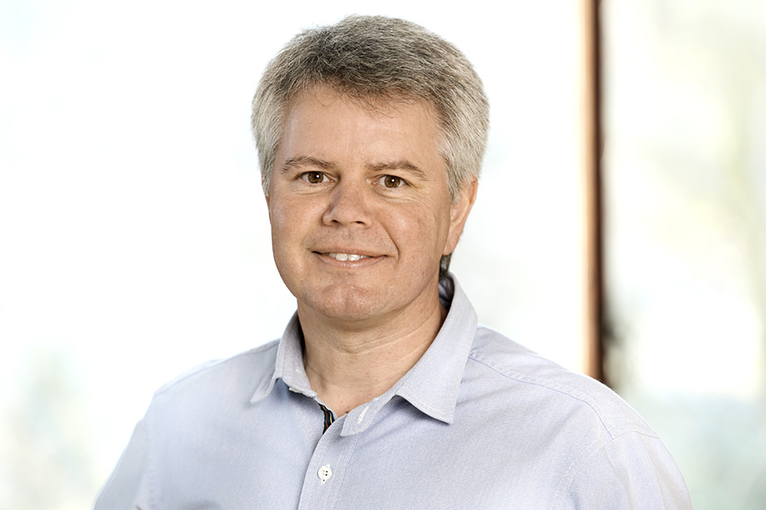
Mig
Michael E. Caspersen
Direktør for It-vest – samarbejdende universiteter
Adjungeret professor ved Aarhus Universitet (AU)
Tidligere
Lektor i programmeringsdidaktik ved Institut for Datalogi på AU
Leder af Center for Computational Thinking, AU (2015-2017)
Leder af Center for Scienceuddannelse, AU (2009-2015)
Leder af Aarhus Graduate School of Engineering (2008)
It-vest-leder ved AU (2002-2008)
Forskningsleder, B&O-lab ved AU (2000-2002)
Forskningsmedarbejder i Center for Objektteknologi (1998-2002)
Underviser på datamatikeruddannelsen i Aarhus (1986-1997)
Udvikling
Uddannelsesudvikling på alle uddannelsesniveauer
Erhvervsakademi: datamatiker og datanom (1988-1996)
Universitet: bachelor-, kandidat- og masteruddannelser (1999-)
Ungdomsuddannelser: Informatikfaglighed (2008-)
Grundskolen: Informatikfaglighed (2017-)
Forskning, tillidsposter, ...
60 videnskabelige publikationer, tre bøger, ...
Chair for 10 internationale konferencer
Distinguished member of ACM
Bestyrelsesmedlem for Informatics Europe
Medlem af Informatics for All Steering Committee
Har undervist i mere end 35 år
og udviklet uddannelser i mere end 30 år
Har de seneste godt 20 år haft diverse ledelsesjob i universitetsverdenen
Har forsket (i fritiden) i godt 20 år
Ph.d. i programmeringsdidaktik
"Autodidakt didaktiker"

Slide 3
Fag og kompetencer Kompetence = viden + færdighed + adfærd
Viden
Basal viden
Specialiseret viden
Kompetencer
Forskningskompetencer
Undervisningskompetencer
Udviklingskompetencer
Forskning
Basal
faglighed
Speciali-sering
Undervisning
Udvikling

Slide 4
It-kompetencer
Forskningskompetencer
Undervisningskompetencer
Udviklingskompetencer
Forskning
Hvordan bedriver man forskning i it?
Dvs. hvordan tilvejebringer og skaber man ny viden om it?
Undervisning
Hvordan underviser man i it?
Dvs. hvordan skaber man effektive læreprocesser i it i f.eks. de gymnasiale uddannelser?
Udvikling
Hvordan er man kreativt og konstruktivt skabende med it? Dvs. hvordan bruges it til at forstå, ændre og skabe produkter, services, processer og organisationer?

Slide 5
It-professionskompetencer Forskning, undervisning, udvikling
Specific Content
Knowledge
[ The Essential ]
Content
Knowledge
(CK)
Generic Skills
Forskning
Research Content
Knowledge
(RCK)
Research
Knowledge
(RK)
Basal
faglighed
Speciali-sering
Undervisning
Pedagogical Content
Knowledge
(PCK)
Pedagogical
Knowledge
(PK)
Udvikling
Development Content
Knowledge
(DCK)
Development
Knowledge
(DK)

Slide 6
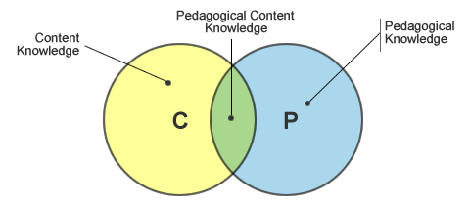
Informatics Didactics PCK of Informatics
The good teacher must master
The subject matter
Pedagogical Content Knowledge (PCK)
PCK provides answers for these questions
Why should the subject matter be taught as a school subject?
What topics do we find appropriate as subject matter?
How do individuals experience the subject?
How can the subject matter come to be understood?
How can it be misunderstood?
What counts as understanding of specific content?
How to organise progression of the subject?
How to evaluate and assess the subject (formative and summative evaluation and feedback)
In short
Provide a foundation for answering the traditional didactical questions: why, what, how, and for whom?

Slide 7

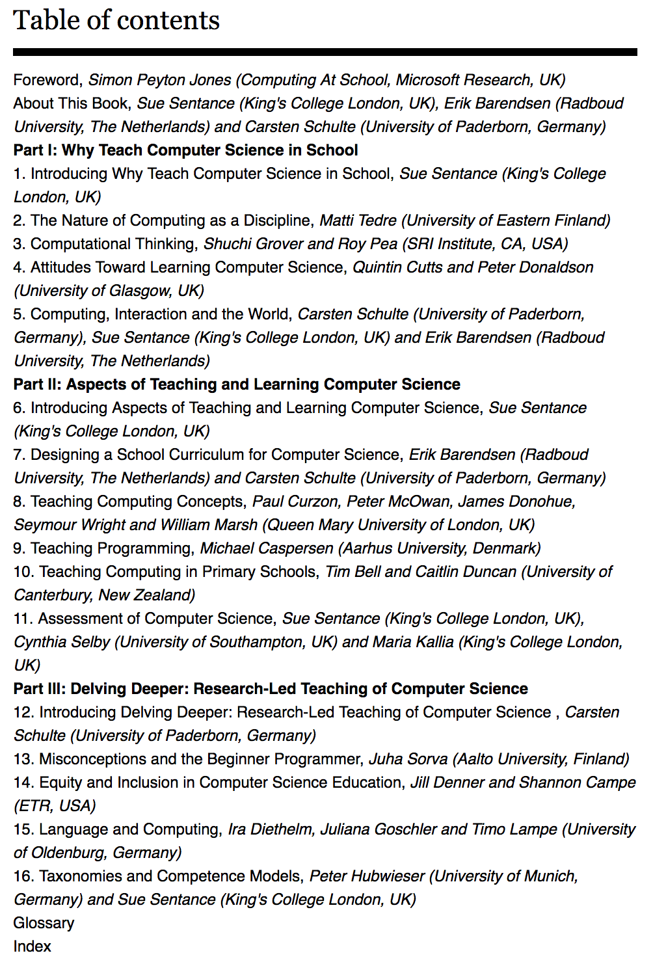
Computer Science Education
22nd March 2018
https://www.bloomsbury.com/uk/computer-science-education-9781350057111/

Slide 8
Ch 9: Teaching Programming 12 Didactical Principles in Four Categories
Progression
Be application-oriented
From consumer to producer (use-modify-create)
Complexity of tasks, not complexity of language constructs
Examples
Provide exemplary examples
Provide worked examples
Passion, play, peers, and projects
Abstraction and patterns
Reinforce specifications
Reinforce patterns
Reinforce models and conceptual frameworks
Process
Reveal process and pragmatics
Scaffolding through stepwise self-explanations
Incremental development through Stepwise Improvement

Slide 9
Worked Example
A Worked Example (WE) is an instructional device that provide
a problem solution for a learner to study.
WE include
a problem statement
an approach for solving the problem
WEs are meant to illustrate how other similar problems might be solved (prototypical examples).
The WE approach is particularly relevant to programs of instruction that seek to promote skills acquisition, e.g. problem solving, design, programming, music, chess, etc.

Slide 10
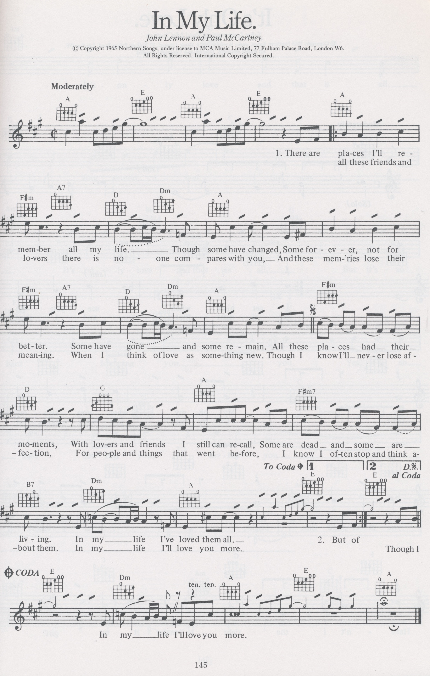
Ex.: Music Composition
Learning goal: Compose a piece of music in three “voices”
Give the melody and most of the two additional voices; ask for the missing bar(s).
...
Give the melody, ask for the two additional voices.

Slide 11
Ex.: Music Composition
Learning goal: Compose a piece of music in three “voices”
Give the melody and most of the two additional voices; ask for the missing bar(s).
...
Give the melody, ask for the two additional voices.

Slide 12
WE with Faded Guidance
represent “atomic” activities in the process of solving a task
represents a model approach to a solution
represents a novice’s attempt at a solution

Slide 13
Some Conferences and Journals Computing Education Research (CER)
Conferences
ACE Australasian CE Conference Jan
SIGCSE Special Interest Group in CSE Mar
CSERC CSE Research Conference Apr
ITiCSE Innovation and Technology in CSE Jun/Jul
ICER International CE Research Conference Aug
WiPSCE Workshop in Primary and Secondary CE Oct/Nov
Koli Calling International Conf. on CE Research Nov
...
Journals
ACM Transactions on Computing Education
Computer Science Education
ACM Inroads
...

